Slide 1




Rascal: Rendezvous and Proximity Operations
Team Bravo
Jennifer Babb
Bryant Gaume
Tom Moline
Tyler Olson
Nate Richard
SRR Presentation
November 12, 2013

Slide 2
Mission Summary
The proposed mission will demonstrate proximity operations and rendezvous within a 6U spacecraft architecture by:
Stationkeeping: Maintain a 10-75 m relative displacement between a target and chase vehicle for at least 5 orbits.
“Escape” Maneuver: Perform an orbital maneuver that intentionally increases the final relative displacement between the target and chase vehicle to at least 100 meters in a maximum time of 1 orbit.
Rendezvous: Perform an orbital maneuver that intentionally decreases the final relative displacement between the target and chase vehicles to within 50 m for a period of time of at least 5 orbits.

Slide 3



Configuration Options
Full 6U satellite
Active – Passive
Active - Active

Slide 4
Configuration Option: 6U
Pros
More power available
No separation required
Cons
SSRL does not have the capabilities to identify and track resident space objects
LSP may not allow rendezvous with resident space object
More delta-v required for operations
Eliminated

Slide 5
Configuration Option: Active - Passive
Pros
Less Complex
Target vehicle accompanies chase vehicle to orbit
Cons
No control over vehicle
Harder to maintain relative velocities
Less redundancy
Possible

Slide 6
Configuration Option: Active - Active
Pros
Redundancy
Target vehicle accompanies chase vehicle to orbit
Replicable
Active control over target vehicle
Cons
Increased mission complexity
More expensive
Possible

Slide 7
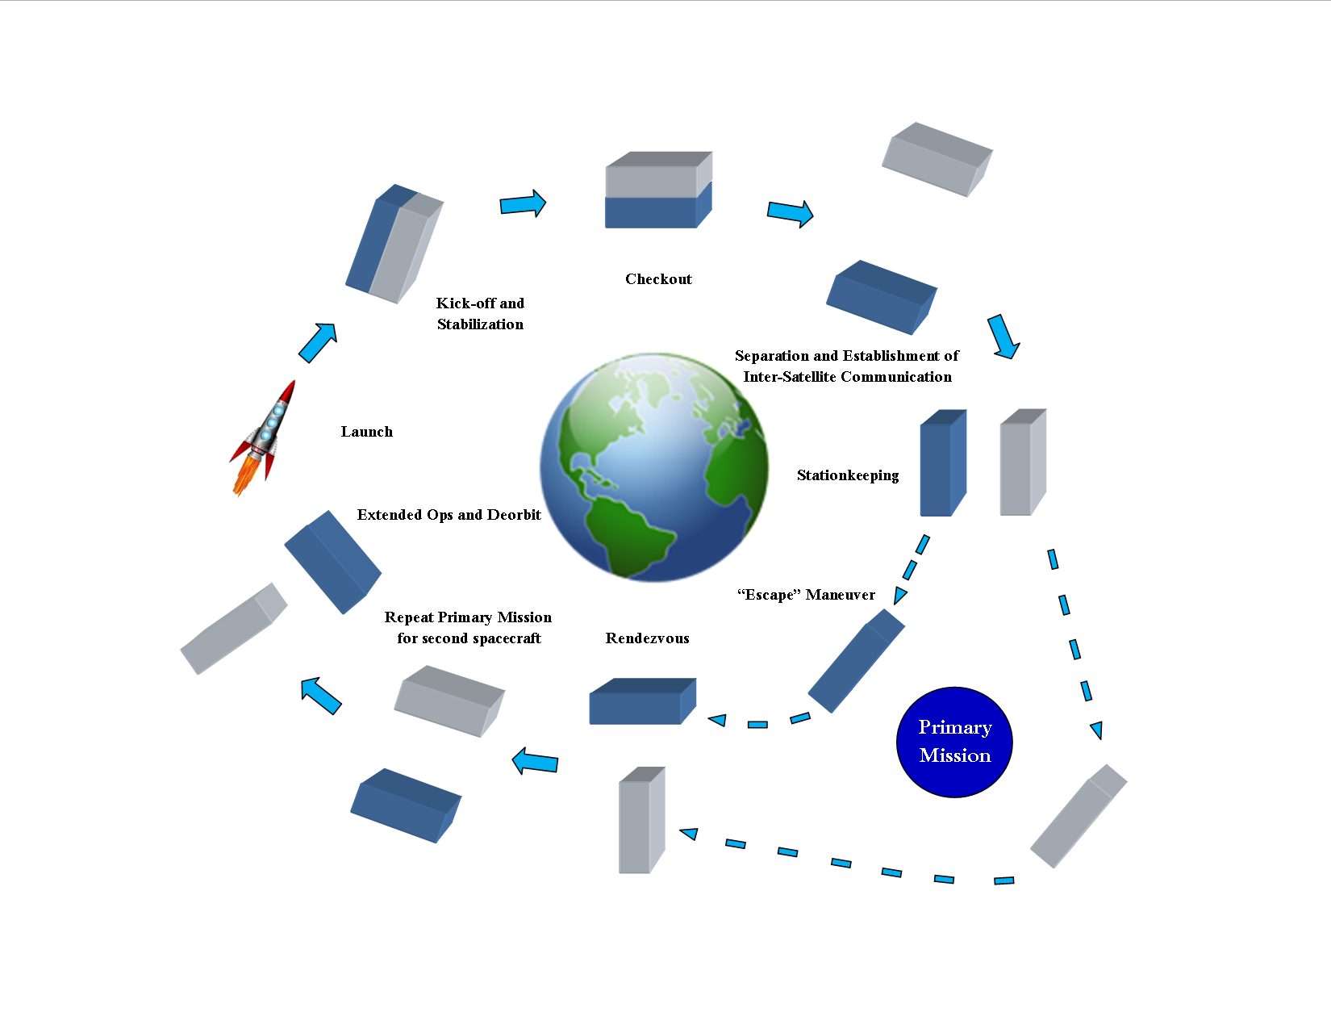
Preliminary Concept of Operations

Slide 8
Requirements Verification Matrix Overview
A Requirements Verification Matrix (RVM) is essentially a list of requirements that, if met, determine the success or failure of a spacecraft mission with respect to:
Meeting Success Criteria Laid out in the Team Bravo RFP
Satisfying Design Constraints Imposed by Deployer Sizes, Orbital Mechanics, Launch Service Providers, Regulatory Agencies, etc
Designing and Completing said mission in a timely, cost-effective manner

Slide 9
RVM Notation and Layout
Each requirement listed in the RVM has a specific identifier associated with it, which can be broken down as follows:
Mission Identifier | Stage Identifier | Subsystem Identifier | Requirement Number
RCL | Pre Launch (PL) | Structures (STR) | Number In Order of Importance (1 = Highest)
 | Post Launch Ejection (PLE) | Thermal (THM)
 | Separation and Stabilization (SS) | Propulsion (PRP)
 | Stationkeeping (SK) | Testing (TST)
 | “Escape” (ESC) | Mission Operations (MOP)
 | Rendezvous (RDZ) | Payload (PLD)
Example: RCL.PL.STR1 Corresponds to the highest priority Structures Subsystem requirement found during the Pre-Launch Mission Phase

Slide 10
Final RVM Note
In the course of creating the RVM, it became increasingly difficult to refer to each separate sub-satellite of the Rascal mission in a meaningful manner.
Hence, a list of potential sub-satellite names were developed, as shown:
Duo Name | Significance
Ginger and Rocky | Two characters from the movie Chicken Run that are attempting to escape from what is essentially a prison (Thus making them fairly Rascal-y characters)
Castor and Pollux | Twin sons of the god Zeus in Greek mythology (Would be especially applicable if each sub-satellite of Rascal ended up being identical)
Beta and Gamma | Two characters from the movie Up that are in constant pursuit of a difficult to achieve goal
Jade and Nephrite | Jade is a character from the show Johnny Quest, the progenitor of the mission from which Rascal sprung forth (Bandit), as well as a precious gemstone, which ties the mission back to naming roots put in place at Stanford University. Nephrite is a common gemstone that develops alongside Jade
Jade and Turquoise | Same as previous entry, except that Turquoise was a gemstone commonly used by Native American tribes in arrow making, in the hopes that the arrows embedded with Turquoise had a better chance of finding their mark

Slide 11
RCL.PL.STR1
RVM Requirement Number | RCL.PL.STR1
RVM Requirement Wording | “The total CubeSat system volume shall not exceed 6U”
Validation Method | Examine
Met by verifying the maximum outer dimensions of the CubeSat system fall within those dictated by a 6U architecture (20 cm x 10 cm x 300 cm) and performing a fit check with the 6U deployer.

Slide 12
RCL.PL.STR2
RVM Requirement Number | RCL.PL.STR2
RVM Requirement Wording | “The total CubeSat system mass shall not exceed 8.0 kg”
Validation Method | Examine
Met by weighing the integrated spacecraft prior to launch vehicle integration.

Slide 13
RCL.PL.STR3
RVM Requirement Number | RCL.PL.STR3
RVM Requirement Wording | “All materials used in the CubeSat system shall have a Total Mass Loss of less than 1.0 %”
Validation Method | Analysis
Met by only using materials found on the NASA approved list of low outgassing materials (http://outgassing.nasa.gov).

Slide 14
RCL.PL.STR4
RVM Requirement Number | RCL.PL.STR4
RVM Requirement Wording | “All materials used in the CubeSat system shall have a Collected Volatile Condensable Material of less than 0.1 %”
Validation Method | Analysis
Met by only using materials found on the NASA approved list of low outgassing materials (http://outgassing.nasa.gov).

Slide 15
RCL.PL.MOP1
RVM Requirement Number | RCL.PL.MOP1
RVM Requirement Wording | “The CubeSat system must be in orbit for at least 6 months”
Validation Method | Analysis
Met by constructing an accurate power budget, performing a battery charge / discharge test, performing a day-in-the-life test, performing a solar panel charge test, and performing a solar cell degradation analysis.

Slide 16
RCL.PL.MOP2
RVM Requirement Number | RCL.PL.MOP2
RVM Requirement Wording | “The CubeSat system must deorbit within 25 years of being launched”
Validation Method | Analysis
Met by performing an orbital analysis using orbital parameters for various altitudes to determine orbital lifetime. If the orbital lifetime exceeds 25 years, a deorbit mechanism will be included in the design.

Slide 17
RCL.PL.STR5
RVM Requirement Number | RCL.PL.STR5
RVM Requirement Wording | “The CubeSat system shall be conjoined prior to launch vehicle integration”
Validation Method | Demo
Met by conducting an separation test then an integrated vibration test of the flight unit prior to launch vehicle integration.

Slide 18
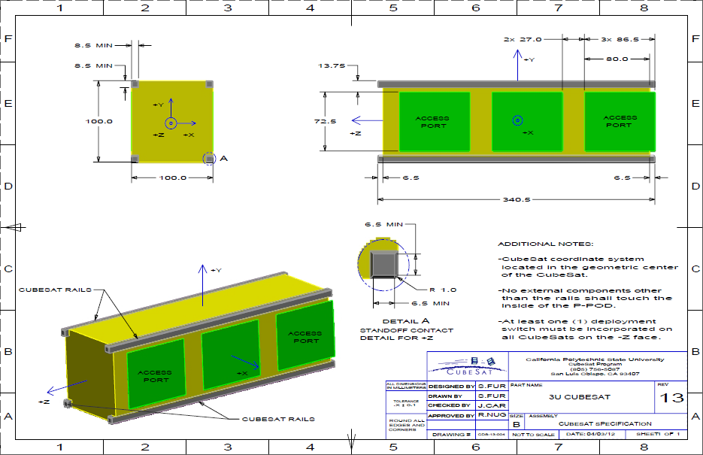
RCL.PL.STR6
RVM Requirement Number | RCL.PL.STR6
RVM Requirement Wording | “The CubeSat shall incorporate a Remove Before Flight pin”
Validation Method | Examine
The Remove Before Flight (RBF) pin is used to cur all power to the spacecraft by physically separating the battery circuit from the rest of the spacecraft, enabling the spacecraft to be handled safely and easily while the pin is inserted.

Slide 19
RCL.PL.STR7
RVM Requirement Number | RCL.PL.STR7
RVM Requirement Wording | “The CubeSat System Shall Incorporate a Deployment Switch”
Validation Method | Examine
Because power going to the CubeSat could interfere with the launch vehicle and primary payload, there must be a deployment switch to turn off CubeSat power during launch.

Slide 20
RCL.PL.STR8
RVM Requirement Number | RCL.PL.STR8
RVM Requirement Wording | “No Protrusion Shall Extend beyond 6.5 mm Normal to Any External Surface of Jade or Turquoise”
Validation Method | Examine
The requirement that there be no extension beyond 6.5 mm normal to any surface of the CubeSat prevents the CubeSat from getting stuck in the deployer.

Slide 21
RCL.PL.STR9
RVM Requirement Number | RCL.PL.STR9
RVM Requirement Wording | “No External Components Other than the CubeSat Rails of Jade and Turquoise may make Contact with the Deployer”
Validation Method | Examine
Due to positioning the CubeSats within the deployer, and the need for a smooth exit from the launch vehicle, no component may extend any further than 6.5 mm normal to any surface of the CubeSat System.

Slide 22
RCL.PL.STR10
RVM Requirement Number | RCL.PL.STR10
RVM Requirement Wording | “The Deployer Shall not be Used to Secure Any CubeSat Deployables”
Validation Method | Demo
This requirement is designed to help ensure the safety and integrity of the individual CubeSats, as well as prevent CubeSats from getting lodged in the deployer.

Slide 23
RCL.PL.STR11
RVM Requirement Number | RCL.PL.STR11
RVM Requirement Wording | “The Center of Gravity of the total CubeSat System Shall be Located within a Sphere of 2 cm of the Geometric Center of the System”
Validation Method | Analyze
The positioning of the center of gravity close to the geometric center for the easier manipulation of the CubeSat system from any point.

Slide 24
RCL.PL.STR12
RVM Requirement Number | RCL.PL.STR12
RVM Requirement Wording | “The Center of Gravity of Jade and Turquoise Shall be Located within a Sphere of 2 cm of their Geometric Center”
Validation Method | Analyze
Jade is sub satellite 1 and Turquoise is sub satellite 2 of the CubeSat system, and having the centers of gravity of each of the cubes close to their geometric centers makes for more coordinated and easy to calculate orbital maneuvers.

Slide 25
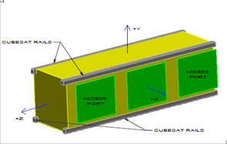
RCL.PL.STR13
RVM Requirement Number | RCL.PL.STR13
RVM Requirement Wording | “The CubeSat System Coordinate System Shall be Defined As Specified in Figure 1-1”
Validation Method | Examine
Defined orientations are crucial in any space mission. Knowing that the Z- surface is inserted into the deployer first, that the railings are along the Y face, and the deployment switch is on the Z- surface leaves no ambiguity.

Slide 26
RCL.PL.STR14
RVM Requirement Number | RCL.PL.STR14
RVM Requirement Wording | “The Local Coordinate System of Jade and Turquoise Shall be Defined as Specified in Figure 1-1”
Validation Method | Examine
Knowing the x, y, and z orientation of Jade and Turquoise allows for consistency between their orientation both apart and together, leading to fewer misunderstandings between the two

Slide 27
RVM Requirement Number | RCL.PL.STR15
RVM Requirement Wording | “The Ends of the Rails on the +Z/-Z Faces of the CubeSat System Shall have a Minimum Surface Area of 6.5 mm x 6.5 mm”
Validation Method | Examine

Slide 28
RVM Requirement Number | RCL.PL.STR16
RVM Requirement Wording | “The +Y/-Y Faces of the CubeSat System Shall have a Length of 100 mm”
Validation Method | Examine

Slide 29
RVM Requirement Number | RCL.PL.STR18
RVM Requirement Wording | “The height of the CubeSat System Shall be 300 mm”
Validation Method | Examine

Slide 30
RVM Requirement Number | RCL.PL.PLD1
RVM Requirement Wording | “Jade and Turquoise Shall be Capable of Determining Relative Displacement between Each Other”
Validation Method | Demo
This requirement stems from the necessity of understanding the relative displacement between Jade and Turquoise after over the course of Rascal’s mission, as to verify the success of particular mission events, such as Rendezvous and “Escape”

Slide 31
RVM Requirement Number | RCL.PL.PLD2
RVM Requirement Wording | “The CubeSat System Shall be Capable of Recording Relative Displacement Data between Jade and Turquoise”
Validation Method | Demo
This requirement stems from the necessity of obtaining the relative displacement between Jade and Turquoise after particular mission events, such as Rendezvous and “Escape”, have already taken place.

Slide 32
RVM Requirement Number | RCL.PL.STR19
RVM Requirement Wording | “Low Friction, 2D Testing of the CubeSat System Release Mechanism Shall be Conducted”
Validation Method | Test
This will be verified through the used of the FRED (Frictionally Reduced Environment Dynamics) system, which consists of a flat platform through which a stream of air will be passed, as to reduce the friction between any object resting on its surface (Such as a Propulsion Unit), and FRED itself, allowing for a more accurate representation of Rascal’s on-orbit environment.

Slide 33
RVM Requirement Number | RCL.PL.PRP1
RVM Requirement Wording | “All Pressure Vessels Shall have a Factor of Safety of No Less Than 4”
Validation Method | Analyze
This requirement will be validated in the design process of any pressure vessel that will be incorporated into the Rascal mission.

Slide 34
RCL.PL.THM1
RVM Requirement Number | RCL.PL.THM1
RVM Requirement Wording | “All CubeSat components shall be rated to withstand a temperature range of at least -20 ⁰C to 70 ⁰C”
Validation Method | Analysis
For those components that are developed at the SSRL, each component that is used in its assembly will be rated to operate within said range.

Slide 35
RCL.PL.PRP2
RVM Requirement Number | RCL.PL.PRP2
RVM Requirement Wording | “Static Thrust testing will be performed with the flight pressure vessel prior to CubeSat integration at a pressure no greater than 1x10^-4 Torr”
Validation Method | Test
The propulsion system must pass the static test fire with no anomalies to meet this requirement.

Slide 36
RCL.PL.PRP3
RVM Requirement Number | RCL.PL.PRP3
RVM Requirement Wording | “The pressure vessel must pass thermal cycle testing between temperatures of -30 ⁰C and 70 ⁰C for a total of two cycles or 10 hours”
Validation Method | Test
The propulsion system shall perform static thrusts before the thermal cycle, during the cycle at various points, and finally, after the thermal cycle.
Rascal Thermal Cycle Test Profile

Slide 37
RVM Requirement Number | RCL.PL.PRP4
RVM Requirement Wording | “Low Friction, 2-D Dynamic Thrust Testing Shall be Conducted with All Pressure Vessels”
Validation Method | Test
This will be verified through the used of the FRED (Frictionally Reduced Environment Dynamics) system, which consists of a flat platform through which a stream of air will be passed, as to reduce the friction between any object resting on its surface (Such as a Propulsion Unit), and FRED itself, allowing for a more accurate representation of Rascal’s on-orbit environment.

Slide 38
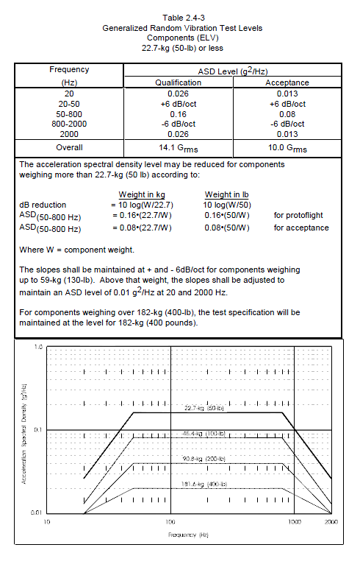
RCL.PL.TST1
RVM Requirement Number | RCL.PL.TST1
RVM Requirement Wording | “CubeSat must survive Random Vibration Testing relative to the NASA GEVS Qualification Profile”
Validation Method | Test
Using the GEVS profile covers as many vibration environments as possible.
NASA GEVS Random Vibration Profile

Slide 39
RCL.PL.TST2
RVM Requirement Number | RCL.PL.TST2
RVM Requirement Wording | “CubeSat shall be subjected to a temperature of 60 ⁰C at a pressure of 1x10^-4 Torr for at least 6 hours”
Validation Method | Test
This is called a bakeout and its purpose is to remove volatile material from the CubeSat system so it does not damage nearby spacecraft.

Slide 40
RCL.PL.TST3
RVM Requirement Number | RCL.PL.TST3
RVM Requirement Wording | “Full CubeSat System shall be able to execute all commands associated with its operation over RF”
Validation Method | Test
The requirement needs to be met so the CubeSat system can perform functional tests.

Slide 41
RCL.PL.TST4
RVM Requirement Number | RCL.PL.TST4
RVM Requirement Wording | “Full CubeSat System shall be able to close a link with the SSRL Ground Station from a distance of at least 200 meters”
Validation Method | Test
It has been required by the Air Force Research Laboratory before testing can take place there, thus leading to its requirement for the Rascal mission. It also improves confidence in the reliability of the Rascal communication system prior to launch.

Slide 42
RCL.PL.TST5
RVM Requirement Number | RCL.PL.TST5
RVM Requirement Wording | “Full CubeSat System shall be able to document the functionality of each subsystem through the running of a full-functional test”
Validation Method | Test
To meet this requirement each subsystem in the CubeSat system must successfully execute any on-orbit command that could potentially be sent to it, as well as demonstrate key on-orbit operations.

Slide 43
RVM Requirement Number | RCL.PLE.MOP1
RVM Requirement Wording | “The CubeSat System Shall not Broadcast in RF Until Ejection +45 Minutes”
Validation Method | Demo
Meeting this requirement can be demonstrated on the ground through the successful completion of a Day in the Life Test.

Slide 44
RVM Requirement Number | RCL.PLE.MOP2
RVM Requirement Wording | “The CubeSat System Shall not Release Deployables Until Ejection +45 Minutes”
Validation Method | Demo
Meeting this requirement can be demonstrated on the ground through the successful completion of a Day in the Life Test.

Slide 45
RVM Requirement Number | RCL.PLE.MOP3
RVM Requirement Wording | “The CubeSat System Shall Establish Communication between Itself and the SSRL Ground Station”
Validation Method | Analyze
The verification of successfully meeting subsequent requirements necessitates a communication link between the CubeSat system and the ground. This allows for post-maneuver verification of relative distances, roll rates, and fuel burn over the course of the mission.

Slide 46
RVM Requirement Number | RCL.PLE.MOP4
RVM Requirement Wording | “The CubeSat System Shall Pass a Health Check Administered from the SSRL Ground Station”
Validation Method | Analyze
A health check consists of verifying that each subsystem of Jade or Turquoise has successfully survived delivery, integration, transportation, and launch before leading in to their actual missions.

Slide 47
RVM Requirement Number | RCL.SS.MOP1
RVM Requirement Wording | “Jade and Turquoise Shall be Capable of Separating from One Another with a Relative Velocity no Greater than 5 cm/s”
Validation Method | Analyze
One of the major failure points of previous Proximity Operations missions has been the problem of initial conditions.
If the initial relative velocity between Jade and Turquoise is too large, extremely large relative displacements can develop between each of them.
This problem can be alleviated by reducing this initial relative velocity value such that the maximum displacement between Jade and Turquoise never goes above 100 meters.
5 cm/s was selected based on relative orbital analyses made in MatLab for various initial relative velocities

Slide 48
RVM Requirement Number | RCL.SS.MOP1 (Continued)
RVM Requirement Wording | “Jade and Turquoise Shall be Capable of Separating from One Another with a Relative Velocity no Greater than 5 cm/s”
Validation Method | Analyze
Relative Displacement Magnitude for 10 cm/s Initial Relative Velocity
Relative Displacement Magnitude for 50 cm/s Initial Relative Velocity

Slide 49
RVM Requirement Number | RCL.SS.MOP2
RVM Requirement Wording | “Jade and Turquoise Shall Achieve a Local Slew Rate of Less Than 1 deg/s”
Validation Method | Analyze
Based on slew rate data obtained from previous CubeSat missions, a CubeSat with a slew rate of less than 1 deg/s can be considered to have attained stability.

Slide 50
RVM Requirement Number | RCL.SS.MOP3
RVM Requirement Wording | “Jade and Turquoise Shall Record Relative Displacement Data Between Each Other at Least Once a Second”
Validation Method | Analyze
This requirement serves as a means to verifying other requirements associated with the completion Rascal’s primary mission.

Slide 51
RVM Requirement Number | RCL.SK.MOP1
RVM Requirement Wording | “Jade and Turquoise Shall be Able to Stationkeep within a 10-75 meter Sphere of Each Other for at Least 5 Orbits”
Validation Method | Analyze
This requirement comes directly from the Team Bravo RFP and is a key factor in meeting the mission success criteria of the proposed mission.
The process will be initiated by a command from the ground, at which time it would be executed autonomously and validated based on relative displacement data obtained after the fact.

Slide 52
RVM Requirement Number | RCL.ESC.MOP1
RVM Requirement Wording | “Jade and Turquoise Shall be Able to Perform an “Escape” Maneuver that Increases the Relative Displacement Between Each Other to at Least 100 meters within 1 Orbit ”
Validation Method | Analyze
This requirement comes directly from the Team Bravo RFP and is a key factor in meeting the mission success criteria of the proposed mission.
Once again, this process would likely be executed autonomously, with verification of its completion coming after it has already been executed.

Slide 53
RVM Requirement Number | RCL.RDZ.MOP1
RVM Requirement Wording | “Jade and Turquoise Shall be Able to Perform a Rendezvous by Decreasing the Relative Displacement Between Each Other to Within 50 meters for at Least 5 Orbits”
Validation Method | Analyze
This requirement comes directly from the Team Bravo RFP and is a key factor in meeting the mission success criteria of the proposed mission.
This process would be executed at the completion of the “Escape” Maneuver, with verification of its completion coming after it has already occurred.

Slide 54

Questions?

